Slide 1
Better Health By Health Education & Sustained Employment

Slide 2
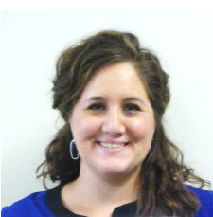
Presenters:
Jillian Hamblin, UnitedHealthcare Chief Operations Office, Project SEARCH Executive Sponsor Alexandra Needler, UnitedHealthcare Rehabilitation Manager, Project SEARCH Business Liaison Jessica Treybig, Fort Bend ISD Project SEARCH Teacher at UnitedHealthcare Patti Moore, Upper Valley Career Center Project SEARCH Coordinator of Upper Valley Medical Center and Koester Pavilion and Ohio Project SEARCH Family Liaison

Slide 3
The Connection Between Health & Employment
Health is determined in part by access to social and economic opportunities known as the social determinants of health including job training, job opportunities, and health literacy. ⁽¹⁾
Studies show that employment increases health status – social, psychological and financial benefits improve health. Studies also show that healthy people are more likely to work – health has an impact on an individual’s desire to work and their likelihood of being hired or retained. ⁽²⁾
Studies have shown that increasing health through exercise increases employment - For instance, recent studies showed that when individuals with physical disabilities exercised and increased their overall health (decreased secondary health conditions), the likelihood they were employed increased by 8.4% ⁽³⁾
1 Office of Disease Prevention and Health Promotion (ODPHP), Social Determinants of Health. www.healthypeople.gov/2020/topics-objectives/topic/social-determinants-of-health
2 Lead Center, 2015, The Impact of Employment on the Health Status and Health Care Costs of Working-age People with Disabilities. www.leadcenter.org
3 Ellie C. Hartman, Ph.D., University of Wisconsin-Stout Vocational Rehabilitation Institute, A Literature Review on the Relationship between Employment and Health: How this Relationship may Influence Managed Long Term Care

Slide 4
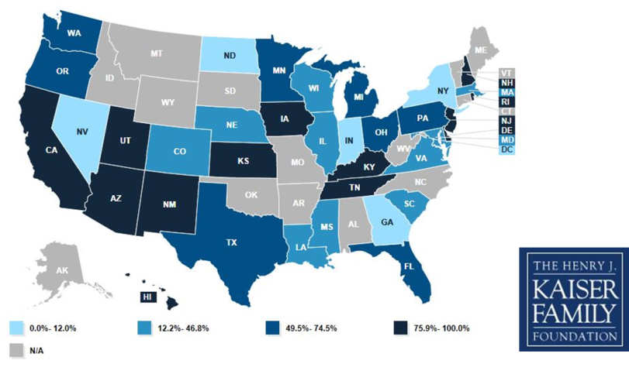
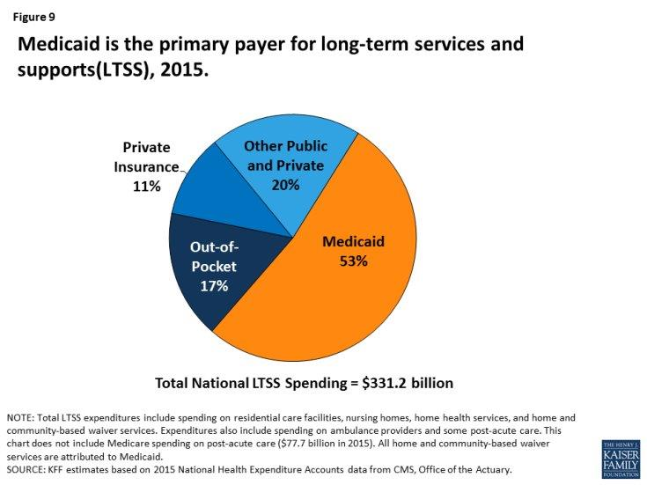
The Role of Managed Care
Increasingly in many states, ID/DD and LTSS waiver services including employment supports and services are being included into managed care.
Federal Government
Basic rules
Funding
Program design approval
Approves contracts and rates
Managed care regulations & consumer protections
State Governments
Program design
Rates
Procurement
Per member per month capitated rate
Oversights
Health Plans
Administer based on contract
Develops network
Coordinates care
Measured against state goals and contract requirements

Slide 5
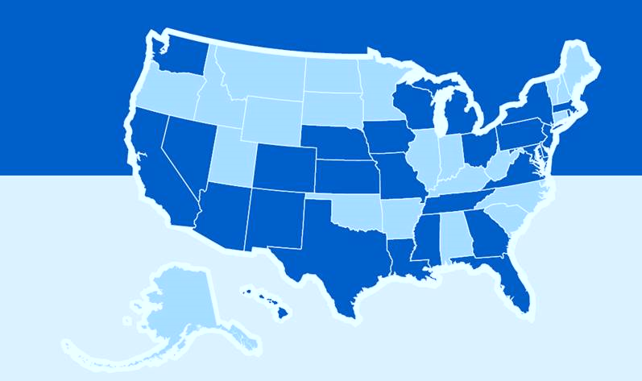
UnitedHealthcare Community and State
As an MCO, UnitedHealthcare is committed to improving the health status, level of community integration and employment outcomes for individuals with disabilities
Person Centered Service Coordination
IDD Pilot in Texas
Administration of Employment Waiver Benefit
Collaboration with Project SEARCH

Slide 6
UnitedHealthcare Plans for
Collaboration with Project SEARCH
Partner with Project SEARCH to help find Host Business
Join an existing site Business Advisory Board
Be a Host Business
TX/AZ
Provide Email Mentor program to existing Project SEARCH site
CT/National
Join existing Host Business site as third rotation
C&S National Sponsorship of Health and Wellness Curriculum in 400 sites

Slide 7
Responsibilities as Stakeholders
As stakeholders in Project SEARCH, we have a responsibility to increase
health literacy of our Project SEARCH interns
By providing health education, we are helping to close the gap in the social
determinants of health that impact the individuals with disabilities that we serve
To aid in the implementation of health education, last year UHC donated 400
copies of the Health Matters Curriculum to Project SEARCH sites
Through health education, such as the Health Matters Curriculum,
Project SEARCH interns have a greater chance of achieving sustained employment
UHC supported Ohio Project SEARCH sites in successful bid for a five year grant
to study the impact of the Health Matters Curriculum on their programs

Slide 8
Health Matters The Exercise and Nutrition Health Education
Curriculum for People with Developmental Disabilities
by Beth Marks, Jasmina Sisirak, and Tamar Heller
Based on successful program developed at the University of Illinois at Chicago
12 week program that includes exercise, nutrition and health education
Supplemental lessons on topics related to health requested by individuals with IDD
Goals of the program include:
Improved fitness & increased knowledge about living healthy lifestyles
Teaching those that support individuals with disabilities to achieve healthy living
Outcomes include:
Greater life satisfaction & increased knowledge and confidence

Slide 9
Suggestions: Incorporating Health Matters
Project SEARCH Course of Study Unit 1: Team Building
Demonstrating the ability to communicate personal needs
Lesson 24: Wants and Needs
Demonstrate the appropriate way to solve a conflict with a team
Lesson 27: Negotiation and Compromise
Project SEARCH Course of Study Unit 2: Workplace Safety
Identify safe working practices related to the workplace
Lesson 25: What is Good Pain and Bad Pain
Project SEARCH Course of Study Unit 3: Technology
Lesson 6: Good Nutrition (visit www.ChooseMyPlate.gov)

Slide 10
Project SEARCH Course of Study 4: Self-Advocacy
Demonstrate understanding of one’s disability
Lesson 9: What do I think of Me? (Disability, Identity & Culture Video)
Explain the rights and responsibilities defined by federal law
Lesson A: Self-Advocacy Rights and Responsibilities
Project SEARCH Course of Study Unit 7: Health and Wellness
The student will explain the impact of health and wellness
Lesson 1: What is Health?
Lesson 8: Healthy Choices/Self-Advocacy
Explain the importance of eating a balanced, nutritious diet
Lesson L: Healthy Food Choices

Slide 11
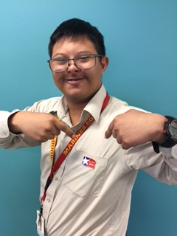
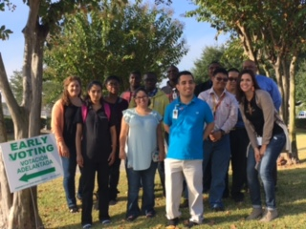
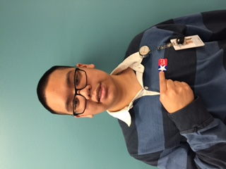
Site Examples – Health Matters/Health Education
Self-Advocacy/Right & Responsibilities – Voting in November 2016 Election

Slide 12
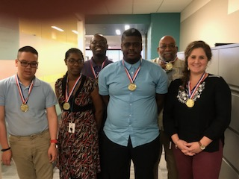
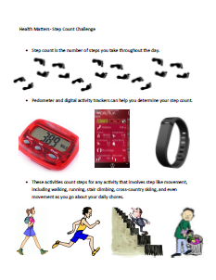
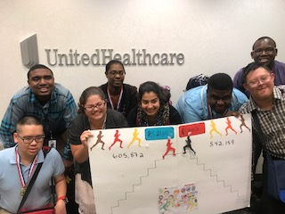
Site Examples – Health Matters/Health Education
Walking Your Way Back to Fitness – Step Challenge

Slide 13
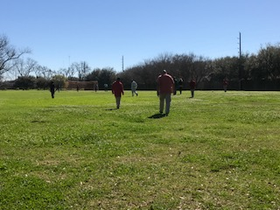
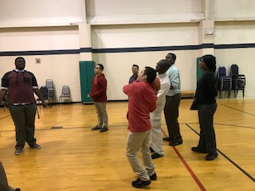
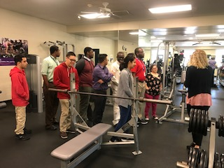
Site Examples – Health Matters/Health Education
Community Fitness Center Visit – Visiting the YMCA

Slide 14
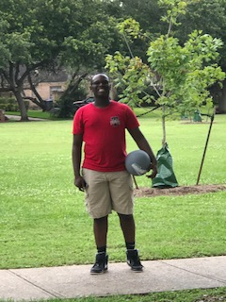
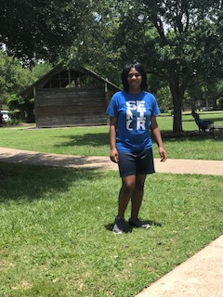
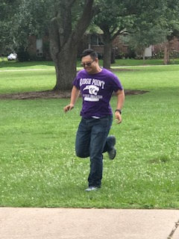
Site Examples – Health Matters/Health Education
New Ideas for Exercising in My Community – Interns at the Park

Slide 15
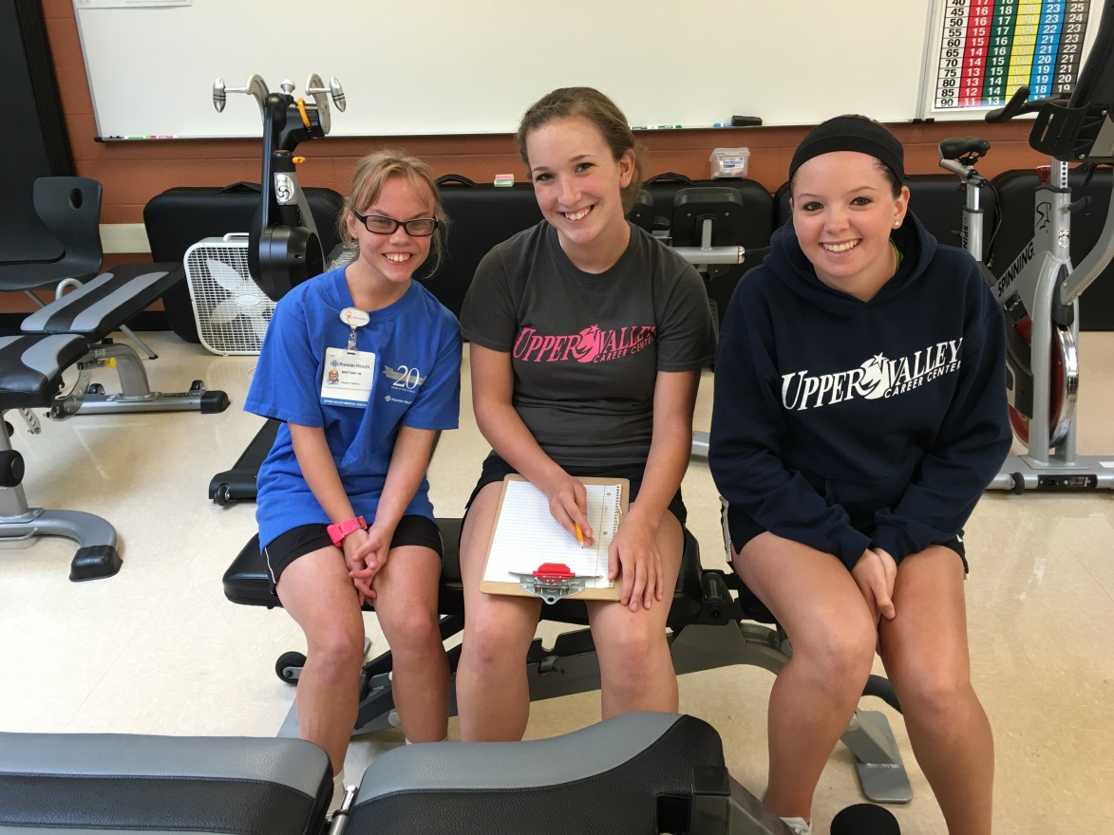
Site Examples – Health Matters/Health Education
Working Out with Buddies from the Senior Exercise Science II Class Weekly

Slide 16
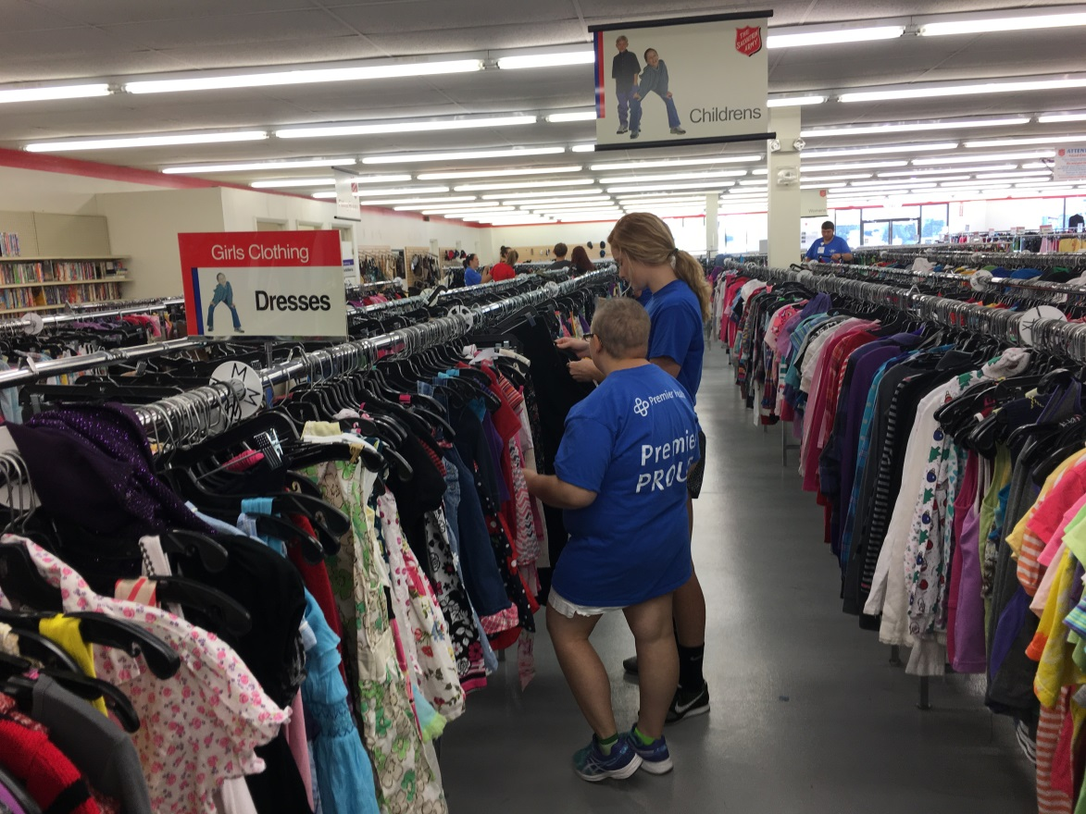
Site Examples – Health Matters/Health Education
Walked and Shopped for Exercise Clothes with their Exercise Science Buddies

Slide 17
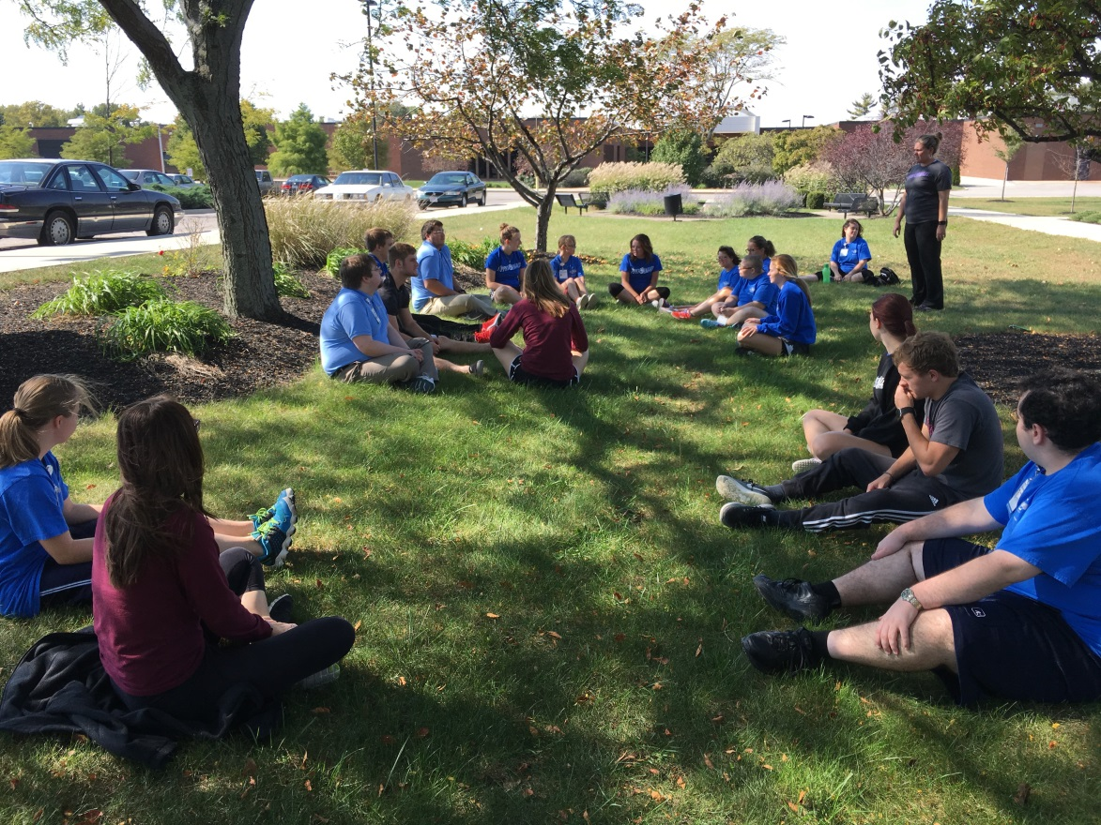
Site Examples – Health Matters/Health Education
Project SEARCH Interns Stretching Outside with their Buddies

Slide 18
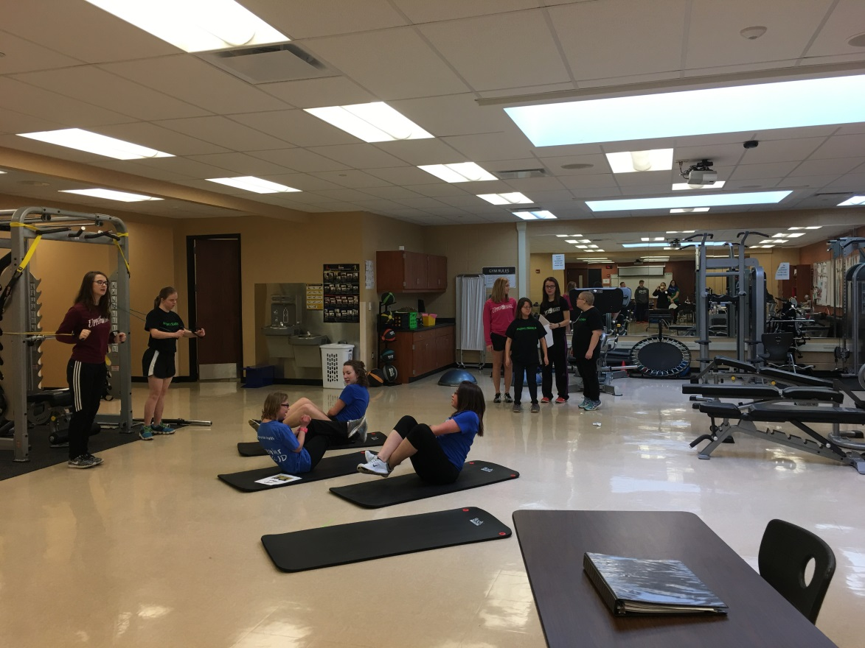
Site Examples – Health Matters/Health Education
Project SEARCH Interns in the Exercise Science II Lab

Slide 19
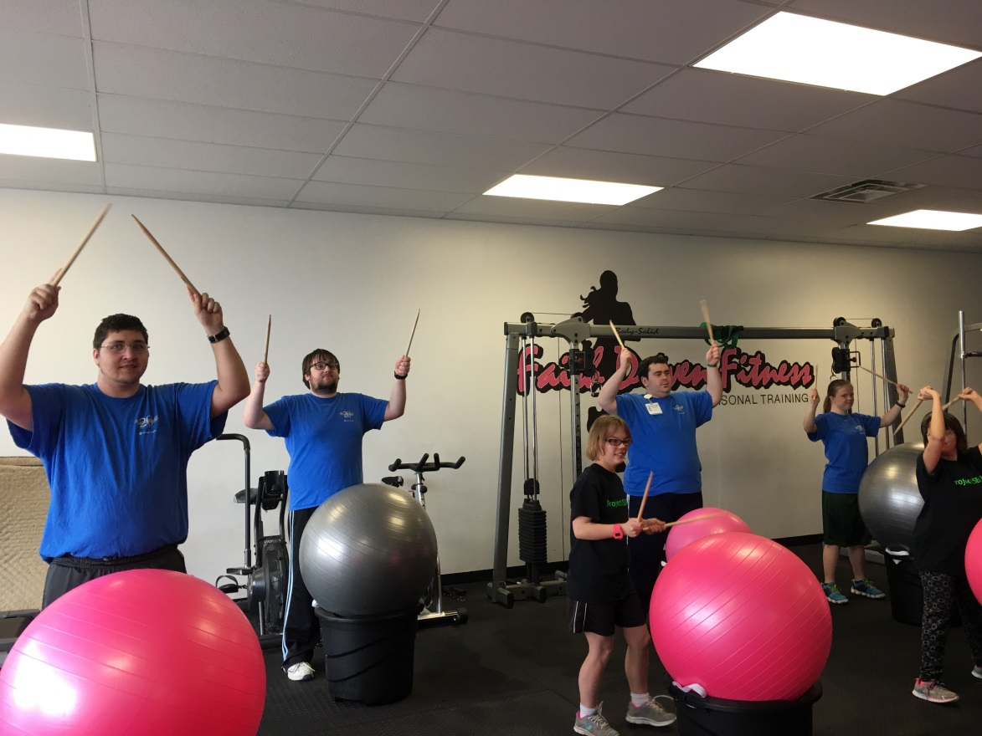
Site Examples – Health Matters/Health Education
Cardio Drum at a Local Fitness Center

Slide 20
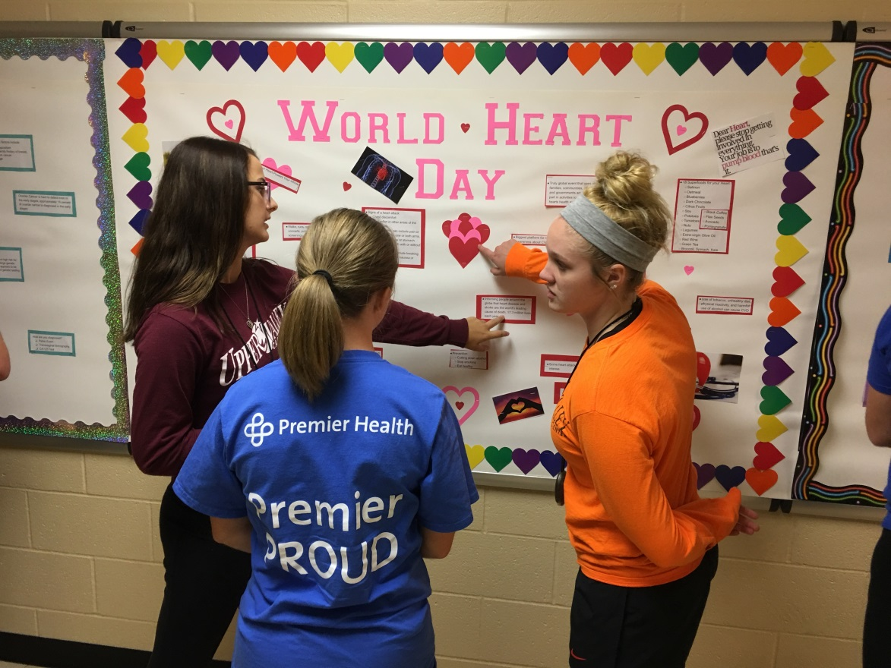
Site Examples – Health Matters/Health Education
Seniors Explain Assignments & Hallway Awareness Program to the SEARCH Interns

Slide 21
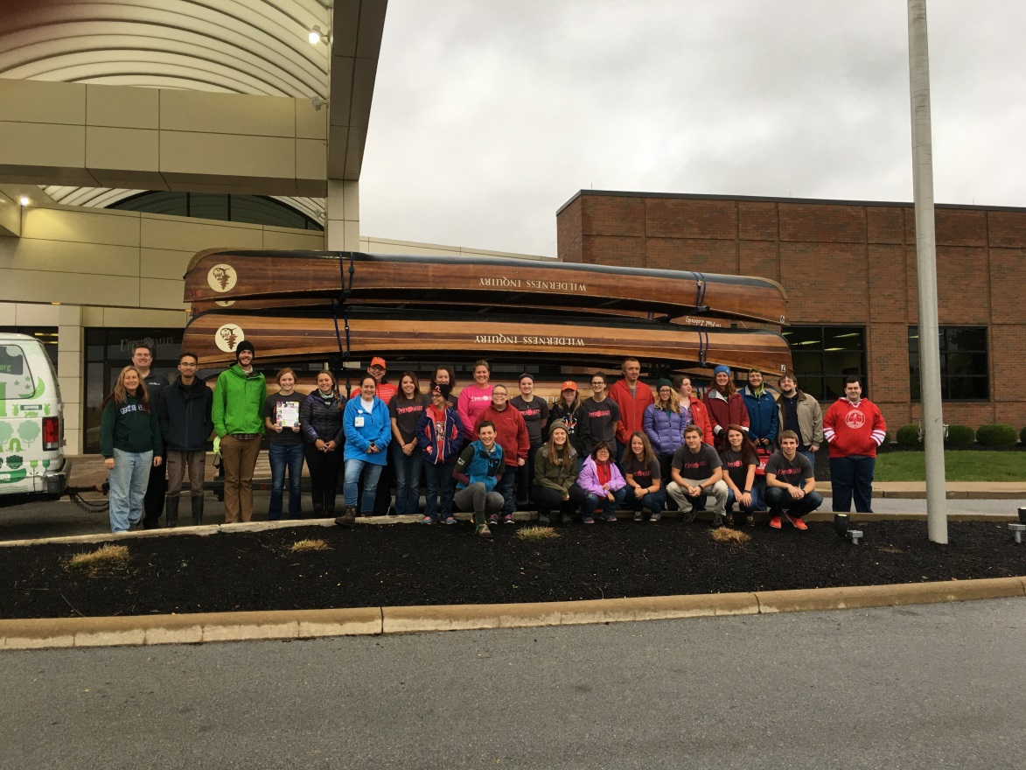
Site Examples – Health Matters/Health Education
Wilderness Inquiry Canoe Mobile - Team Building and Paddling Day

Slide 22
Ideas for 2017 – 2018 Project SEARCH Cohort
Nurse Led Instruction for Lessons: What is My Heart Rate?, What is My Blood Pressure?, What is Cholesterol, What is Diabetes?, What is Heart Disease?
Dietitian Led Instruction for Lessons: Nutrients We Need, Healthy Food Choices, Nutrients in Our Food, How Much Should I Eat?, Portion Sizes Count
Ongoing tracking of water intake
Ongoing step challenge with interns, on-site staff, and host business employees
Instruction of entire curriculum incorporated into preparation and training of Host Business and Project SEARCH Intern Special Olympics Unified Sports Team

Slide 23
Open Forum – Health Matters/Health Education
How has your site incorporated the Health Matters Curriculum and/or Health Education into your site? Please send us pictures of how your site is incorporating the Health Matters Curriculum!
Presenter Contact Information:
Jillian Hamblin – jillian_hamblin@uhc.com
Alexandra Needler – alexandra_needler@uhc.com
Jessica Treybig – jessica_treybig@uhc.com
Patti Moore – moorep@uppervalleycc.org

